Slide 1
Organization of PDF Comment Letters
Team 2481
Notes:
Quick intro

Slide 2
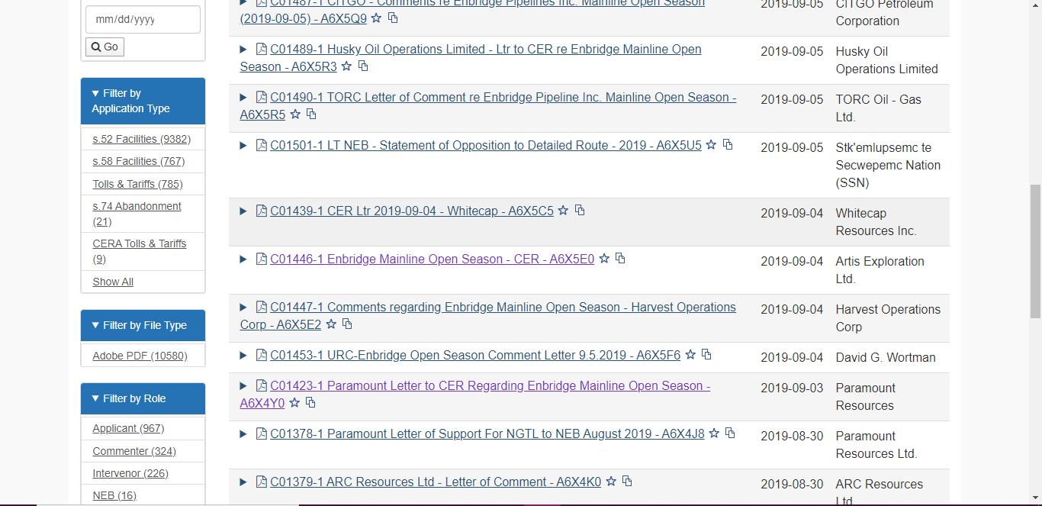
The Problem
Notes:
We were interested in

Slide 3
The Solution
Scrape website for PDF links
Run NLP algorithm to pull relevant data
Merge over project name with project database
Analyze demographic data and subject matter

Slide 4
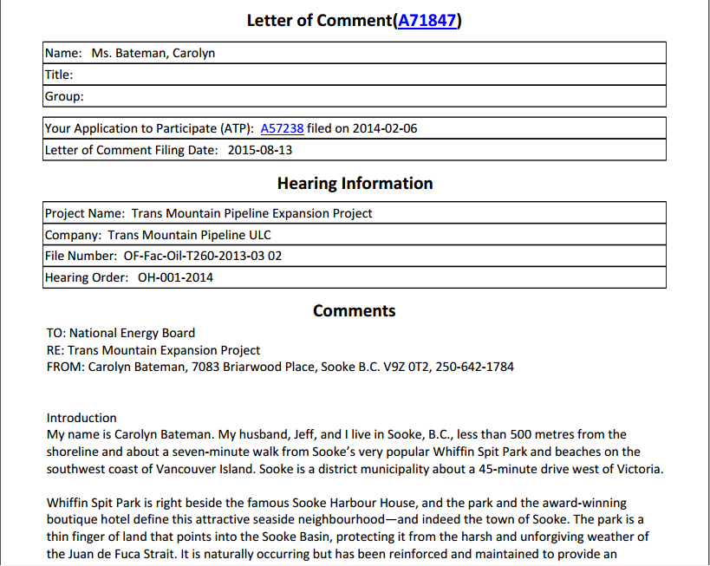
Example

Slide 5
Example
SUBJECT: Environmental Concerns

Slide 6
The Value
Notes:
Show a sample of visualizations, explain the importance of these analyses

